Slide 1
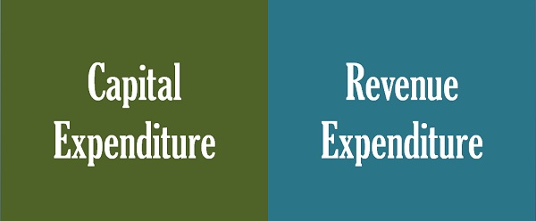
Chapter 4 Financial Accounting
‹#›

Slide 2
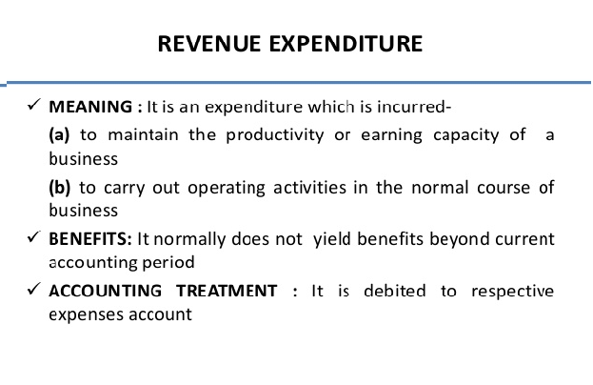
Revenue Expenditure
‹#›

Slide 3
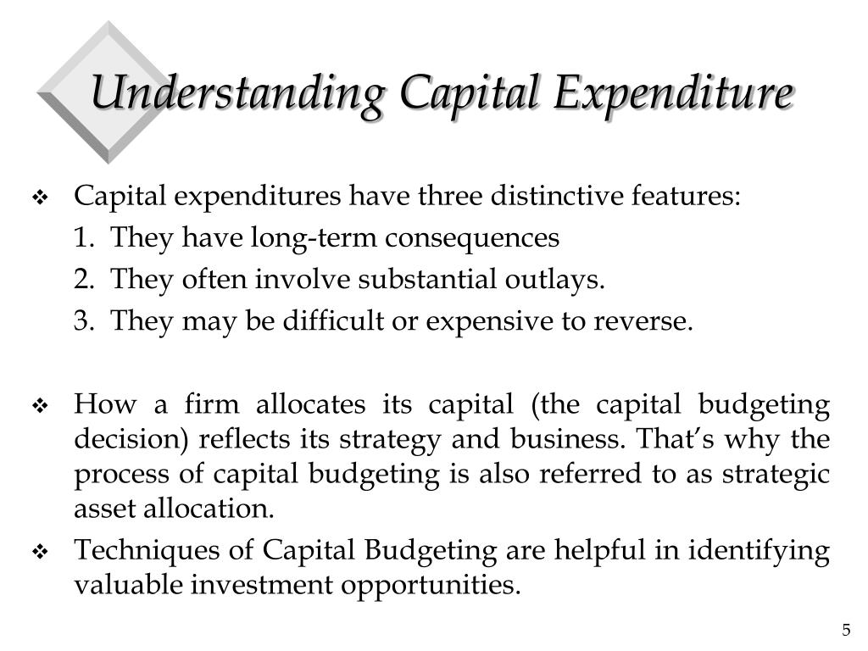
Capital Expenditure
‹#›

Slide 4
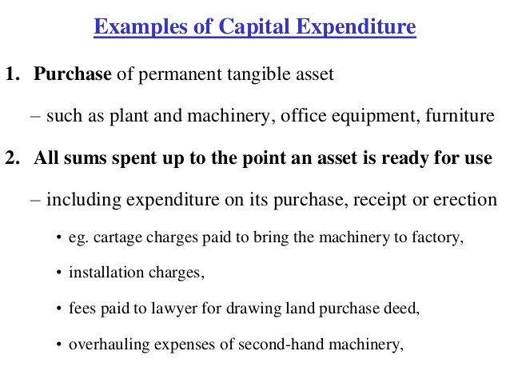
Examples of Capital Expenditure
‹#›

Slide 5
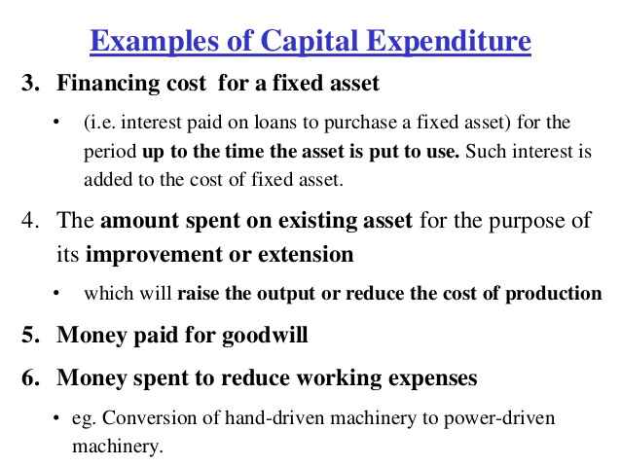
Examples of Capital Expenditure
‹#›

Slide 6
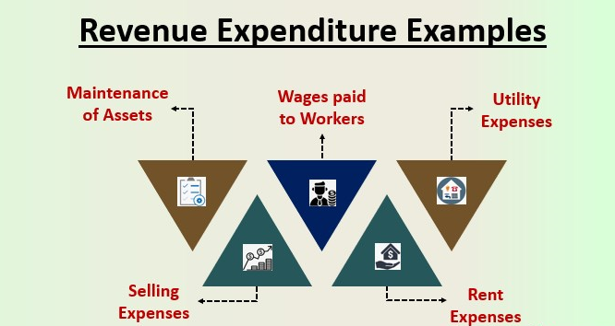
‹#›

Slide 7
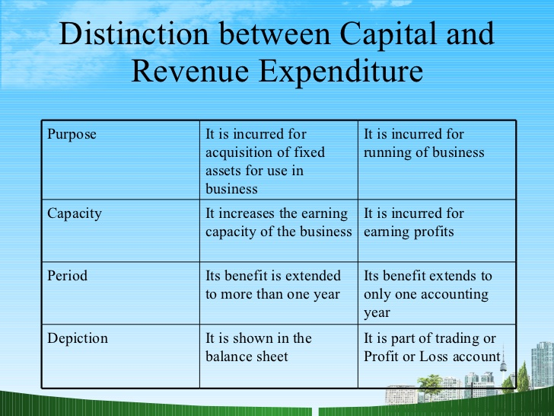
‹#›

Slide 8
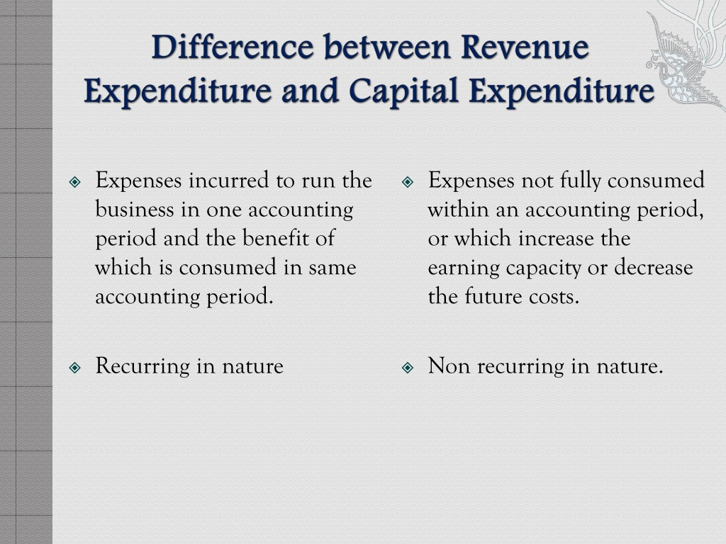
‹#›

Slide 9
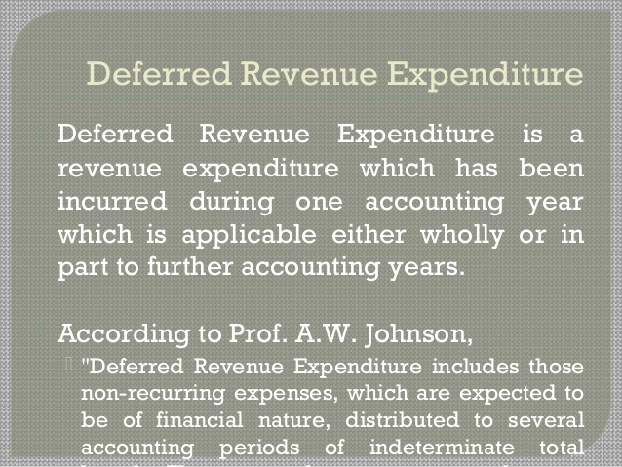
‹#›

Slide 10
Case Study #1
Consider a company XYZ Ltd manufacturing and selling the packets of the pen. The company spends each year for various expenditures such as manufacturing of pens, salaries to employees, Utility bills, repairs and maintenance, acquisition of the assets, etc.
It is not sure about which expenditure to be treated as revenue expenditure.
‹#›

Slide 11
The amount which is spent every year that is required for generating the revenue or maintenance of revenue-generating assets will be considered as the revenue expenditures and the expenses incurred in order to acquire any of the assets or improve the capacity or life of the assets will be treated as the CAPEX.
In the present case amount spent every year for making pens and packing it, to employees, Utility bills, wages to workers, insurance, rent, etc will be categorized as the revenue expenditure.
Apart from this, any cost of repair on the machines which are used for the manufacturing of the pens will also be considered as the revenue expenditure.
On the other side, any amount which the company spends on acquiring the assets or for the purpose of upgrading the machinery used for the manufacturing of the pens for increasing capacity, life or quality, etc will be treated as the capital expenditure of the company.
‹#›

Slide 12
Case Study #2
Company ABC Ltd. started the business of manufacturing and selling bakery items in the market. For that purpose, it buys a machine so that the bakery items can be produced. The owner of the company is arguing that it should be treated as revenue Expenditure. How it should be treated?
‹#›

Slide 13
In the present case, the initial purchase cost of the machinery along with the installation costs will be classified by the business as the capital expenditure because the benefit of the machinery will be derived by the business for the several accounting periods and not in the single accounting period.
‹#›

Slide 14
Case Study #2
However, any subsequent cost incurred on the repair and maintenance of the company will be considered as the revenue expenditure because when the cost of repair and maintenance is incurred, that neither increase the earning capacity of the machine.
‹#›

Slide 15
The machine will be going to produce the same quantity of the bakery products as it used to do earlier when first it was put to use by the business nor it will increase the life expectancy of the machinery i.e.,
‹#›

Slide 16
Case Study #2
the life of the machinery will remain the same as it was at the starting and the cost is incurred just for the maintenance of the asset. So, the initial purchase of the machinery will be considered as capital expenditure and not revenue expense.
‹#›

Slide 17
Classify following
Legal expenses incurred in connection with issues of capital
Expenses incurred in preparing project report
Expenditure for training employees
Amount spent on Uniform of workers
Whitewashing of factory building
‹#›

Slide 18
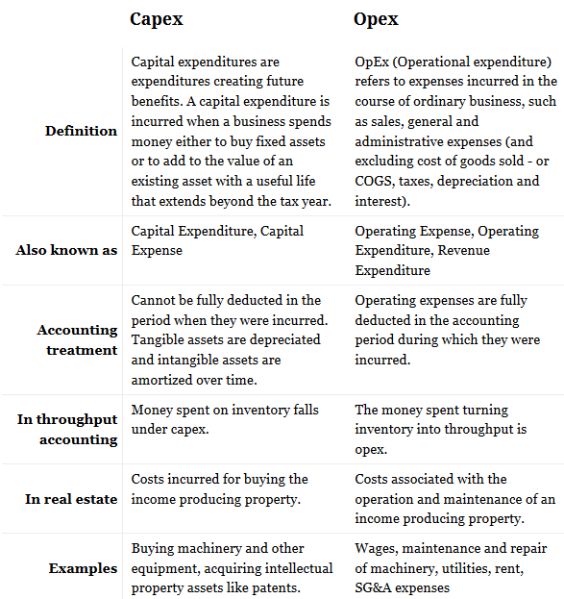
CAPEX VS OPEX
‹#›

Slide 19
Deferred revenue expenditure
is an expenditure which is incurred in the present accounting period but its benefits are incurred in the following or the future accounting periods. This expenditure might be written off in the same financial year or over a period of a few years.
‹#›

Slide 20
Deferred revenue expenditure
Let us take an example. In the case of a startup company, the firm invests heavily in marketing and advertisement in the beginning to capture some position in the market and amongst the competitors. This expense is done in the beginning but the benefits are reaped over several years.
‹#›

Slide 21
Examples of Deferred Revenue Expenditure
Prepaid Expenses: The firm makes a heavy investment in certain activities like sales promotion activities – the benefit for which will be incurred over the number of accounting periods but the expenditure is incurred in the same year. This expenditure will be written off over the number of periods.
Exceptional Losses: Expenditure relating to exceptional losses by for example by earthquake, floods or unforeseen losses by loss or confiscation of property.
‹#›
Notes:
‹#›

Slide 22
Deferred revenue expenditure
Services Rendered: Since the expenditure for the services rendered cannot be allocated to one year only and also there be no asset created with such expenditure. For example the cost of research and development for the company.
Fictitious Asset: Fictitious assets in cases, whose benefit is derived over a long period of time
‹#›

Slide 23
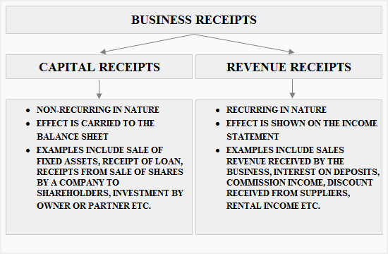
‹#›

Slide 24
Revenue receipts
are funds received by a business as a result of its core business activities. It leads to an overall increase in the total revenue of the company. These funds are generated from a firm’s operating activities hence they are shown inside trading and profit and loss account and not in a balance sheet.
‹#›

Slide 25
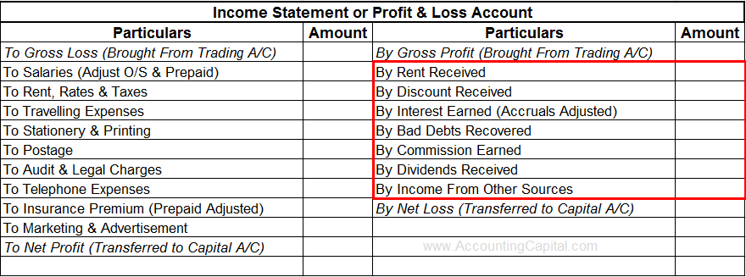
‹#›

Slide 26
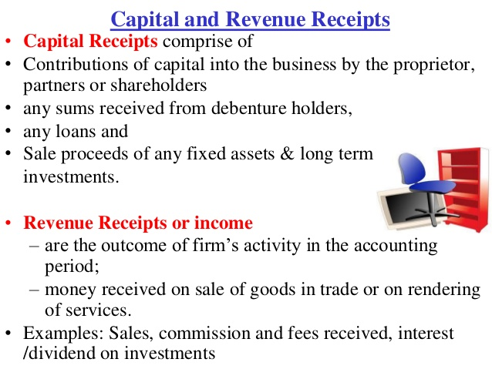
‹#›

Slide 27
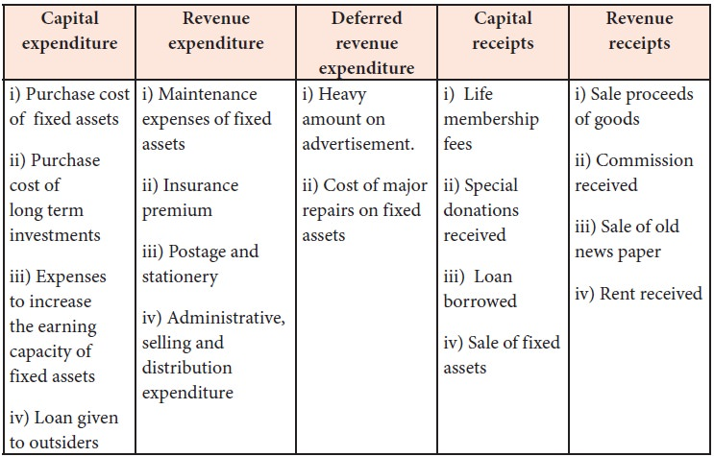
‹#›

Slide 28
Revenue receipts
They are recurring in nature which means that they can be seen quite often and can also be used for distribution of profits. Unlike capital receipts which can not be used to create reserves, revenue receipts are used to create reserve funds.
‹#›

